Slide 1
Quiz Funia
Aao Khele- Revision ka khel

Slide 2
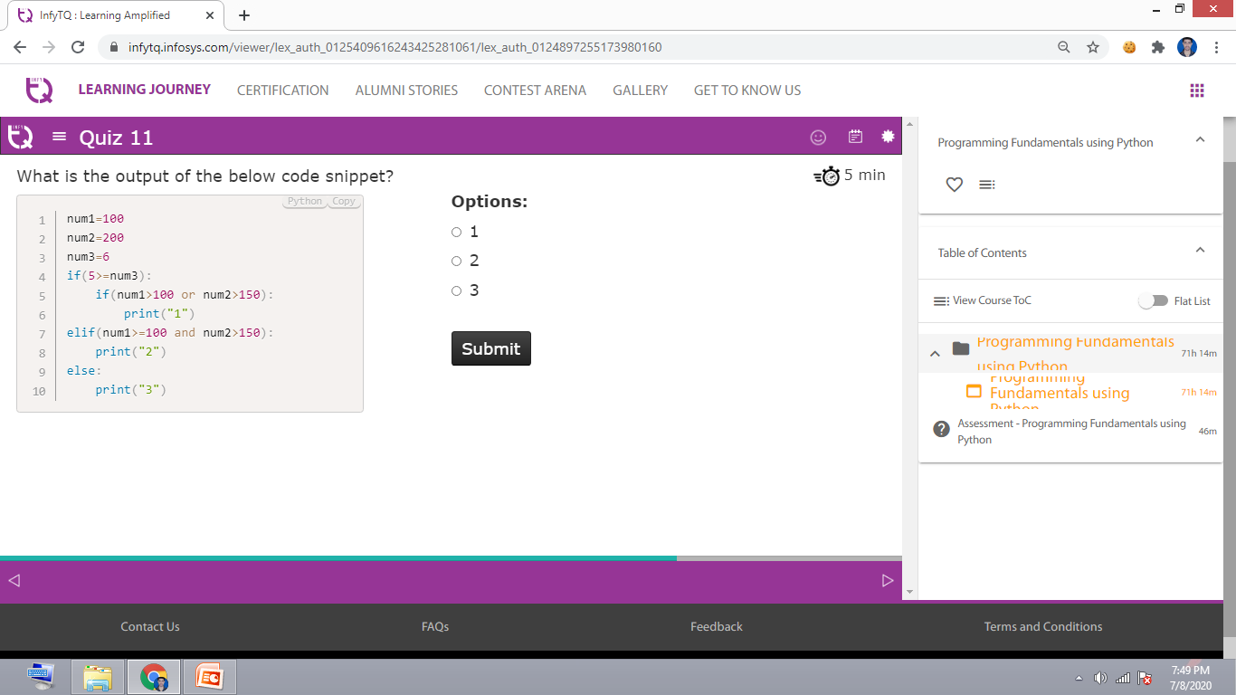

Slide 3
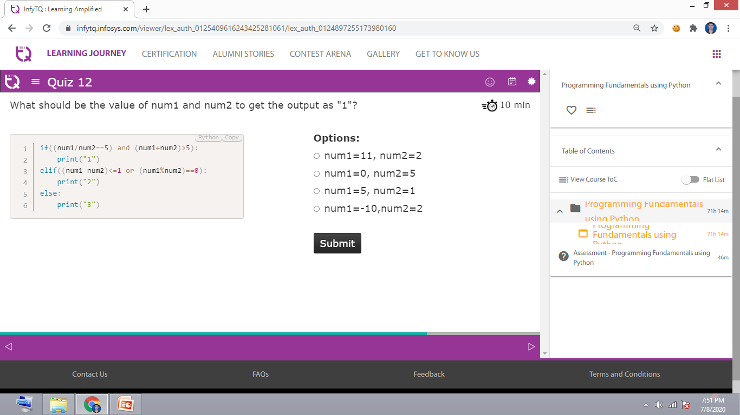

Slide 4
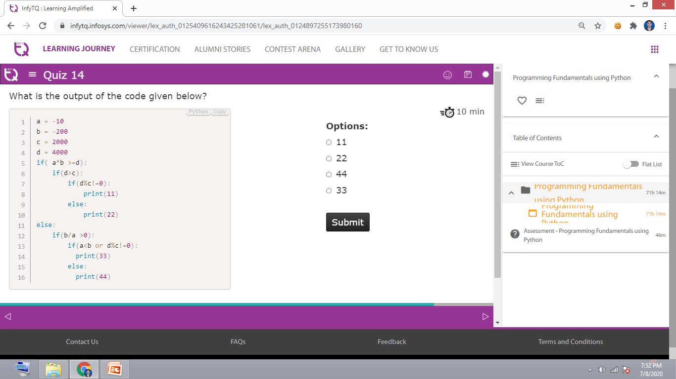

Slide 5
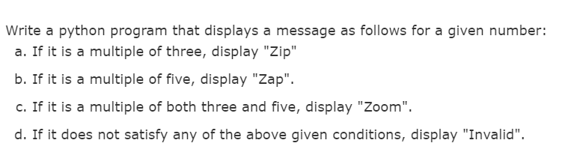
Question 1: 15 minutes

Slide 6
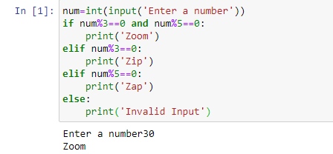
Solution 1:

Slide 7
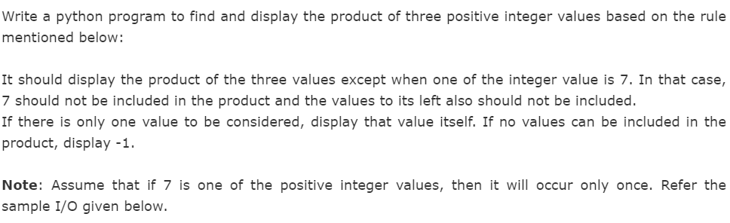
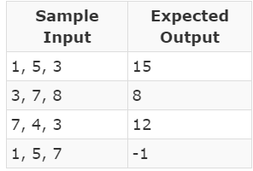
Question 2

Slide 8
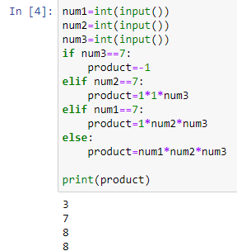
Solution 2
num1=int(input())
num2=int(input())
num3=int(input())
product=1
if num1==7:
num1=1
elif num2==7:
num1=1
num2=1
elif num3==7:
num1=1
num2=1
num3=(-1)
product = num1*num2*num3
print(product)

